Slide 1
EXPLORE Our e-commerce universe where convenience meets choice, and shopping becomes an experience Submitted By: Gursimran Kaur 2210990350 Kunisha DHIR 2210990528 PINAK DHIR 2210990650 PRANAV GUPTA 2210990664 SUBMITTED TO: DR. RAJENDER KUMAR

Slide 2

Brief Overview:
A dynamic web application that is used to facilitate online buying is an e-commerce project constructed using React.js.
Developers utilize React.js to create a dynamic and responsive frontend that allows customers to explore specific product pages, browse product catalogs, and add goods to their shopping carts with ease.
As seamless transactions are made possible by integrated payment gateways, strong user authentication protocols guarantee safe account management.
With the ability to monitor inventory, handle orders, and record customer interactions, administrators are granted access to extensive backend features.

Slide 3
TECHNOLOGY:
Creating an e-commerce website with React.js typically involves using a combination of technologies and libraries to handle various aspects. Here's a rundown of the common ones:
React.js: The core library for building user interfaces.
Redux: For managing the application state, especially useful for handling shopping cart data, user authentication, and other global state needs.
React Router: For handling routing within the application, enabling navigation between different pages or views.

Slide 4
Styled-components or CSS Modules: For styling components, providing a way to encapsulate styles and ensure better maintainability.
React Hook Form: For managing form state and validation, crucial for handling user input during the checkout process.
Axios or Fetch API: For making HTTP requests to fetch data from the server, such as product information or user data.

Slide 5
OBJECTIVES:
The primary objective of an e-commerce website is to facilitate online transactions, providing customers with an intuitive and efficient way to shop for products and complete purchases. Key objectives include:
Specifically, our objectives include:
User-Friendly Interface: Designing a responsive and intuitive user interface that ensures easy navigation and seamless interaction for visitors across various devices.
Shopping Cart Functionality: Developing a functional shopping cart system that allows users to add/remove items, view order summaries, and proceed to secure checkout seamlessly.
3.Order Management: Implementing an efficient order management system to track orders, update order statuses, and provide customers with real-time order updates and notifications.

Slide 6
4.Responsive Design: Ensuring that the website is optimized for various screen sizes and devices, providing a consistent and enjoyable user experience regardless of the device being used.
5.Scalability: Building a scalable architecture that can accommodate growth in both product offerings and user traffic, ensuring the website remains robust and reliable as the business expands.
By accomplishing these objectives, we aim to create a compelling e-commerce platform that not only meets but exceeds the expectations of our customers, ultimately driving sales and fostering long-term customer relationships.

Slide 7
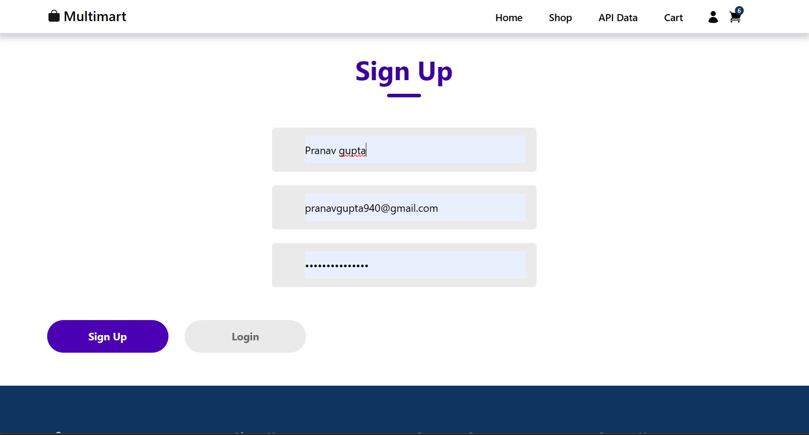
Results:

Slide 8
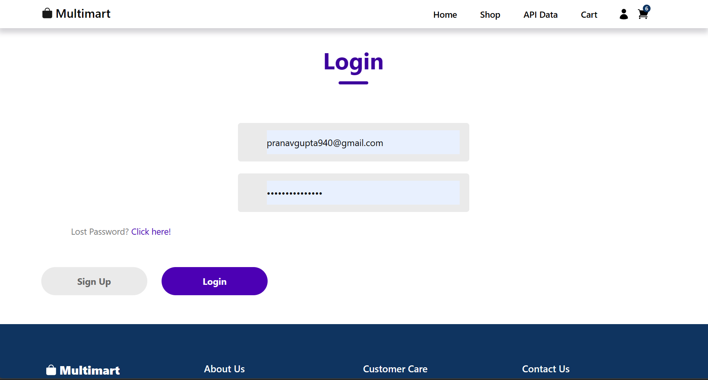
Results:

Slide 9
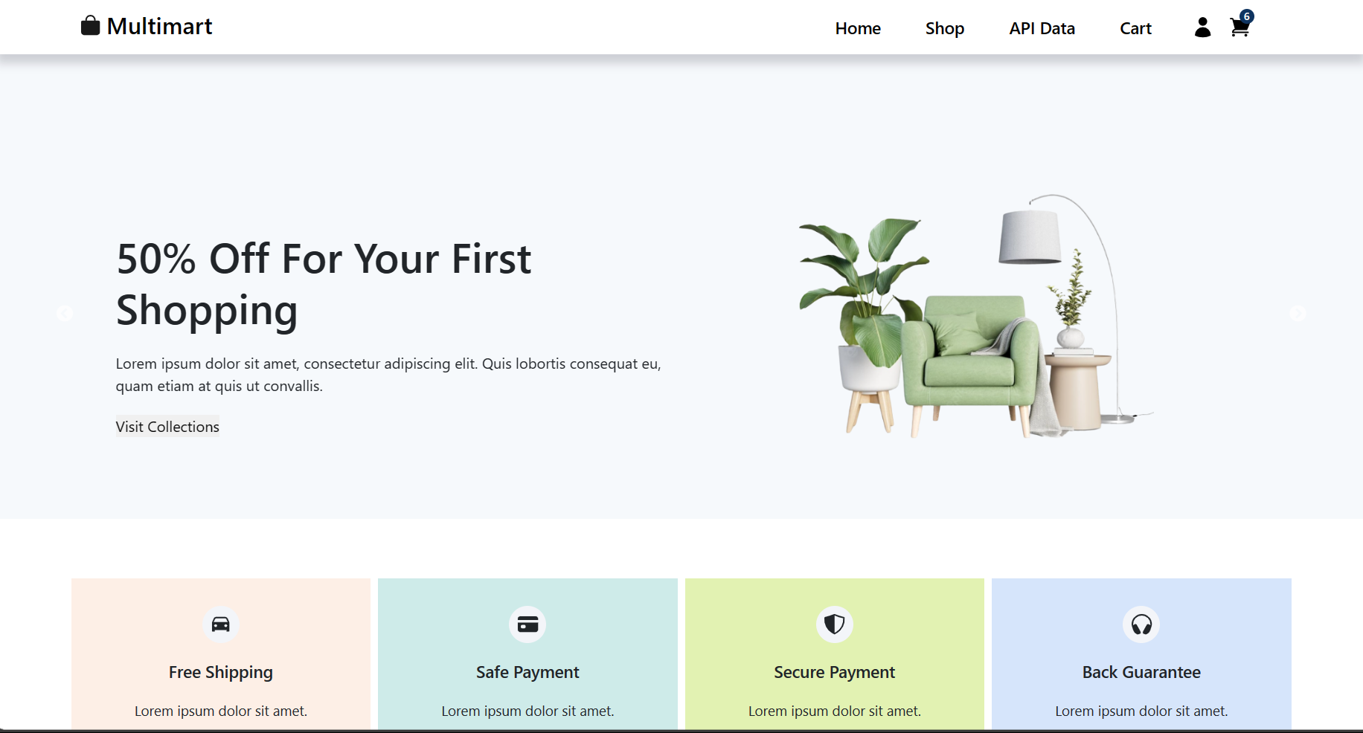

Slide 10
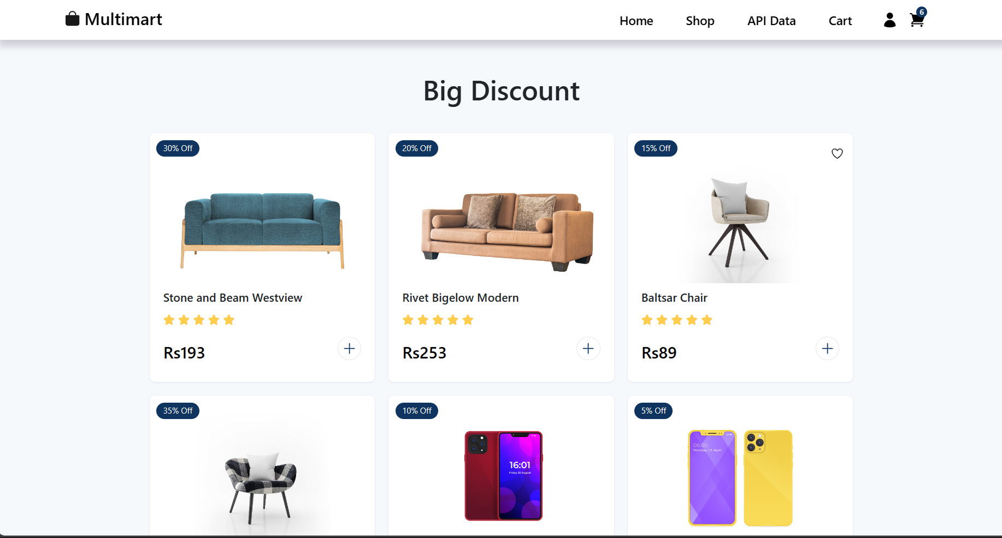

Slide 11
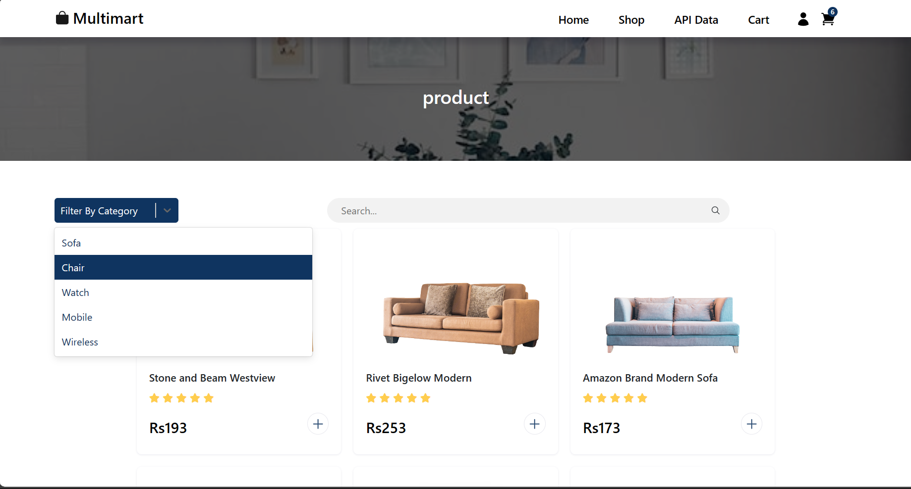

Slide 12
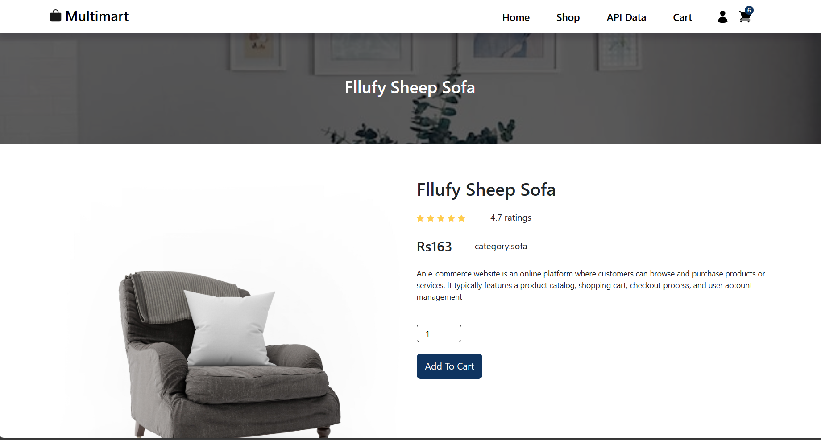

Slide 13
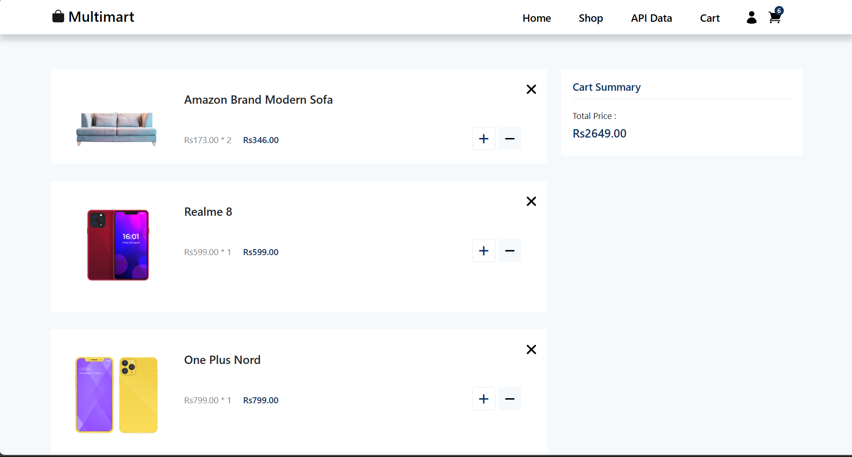

Slide 14
